Slide 1
6. Maxwell’s Equations In Time-Varying Fields
7e Applied EM by Ulaby and Ravaioli

Slide 2
Chapter 6 Overview

Slide 3
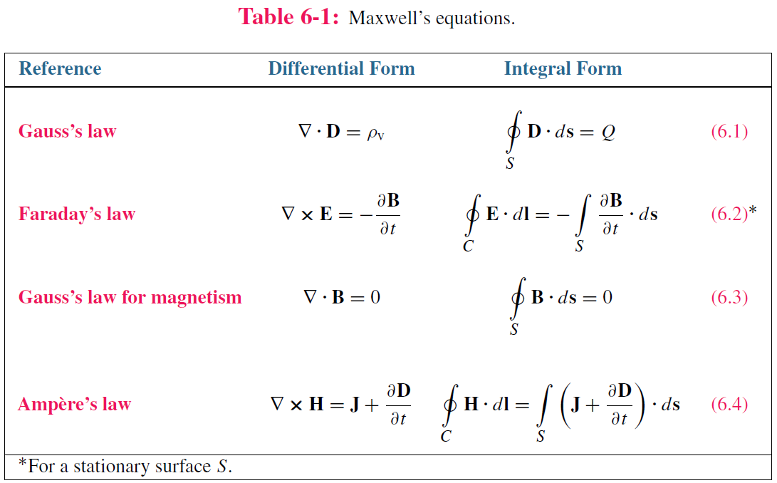
Maxwell’s Equations
In this chapter, we will examine Faraday’s and Ampère’s laws

Slide 4
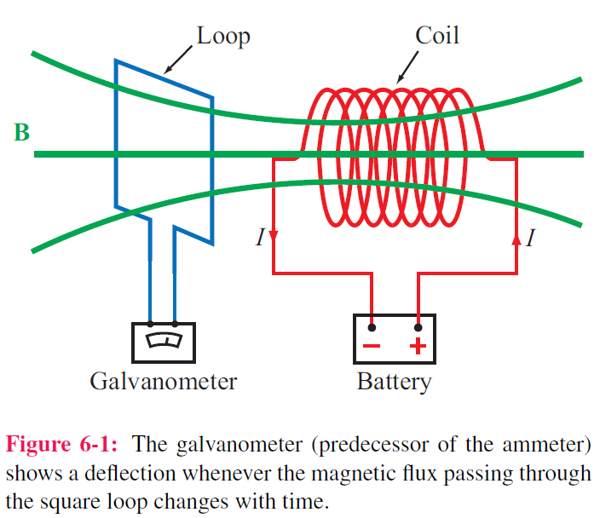
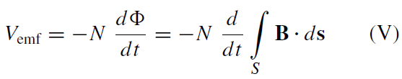
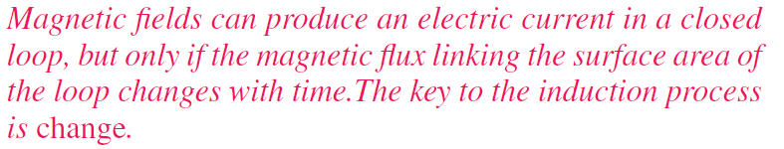
Electromotive Force
Electromotive force (voltage) induced by time-varying magnetic flux:

Slide 5
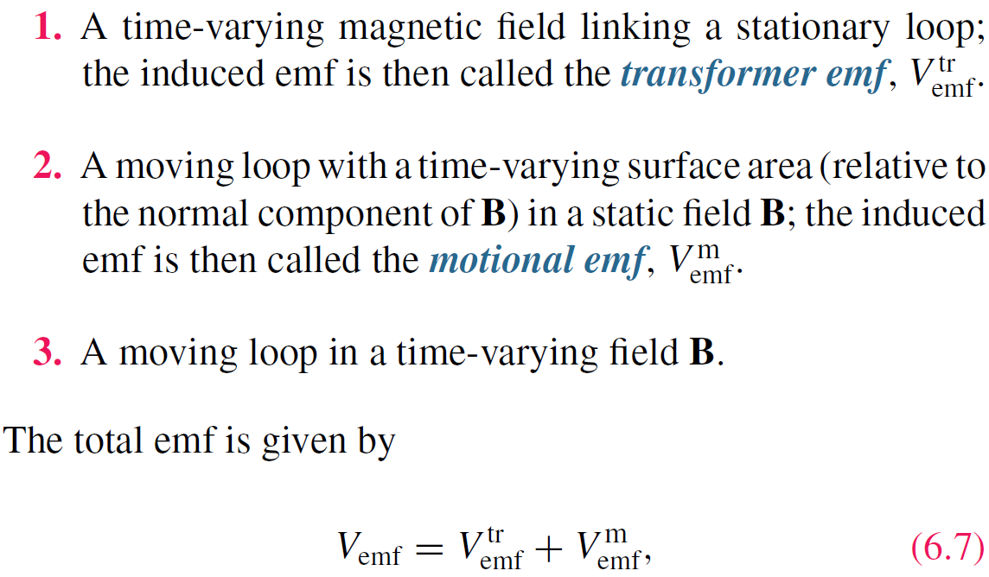
Three types of EMF

Slide 6
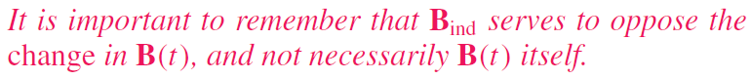
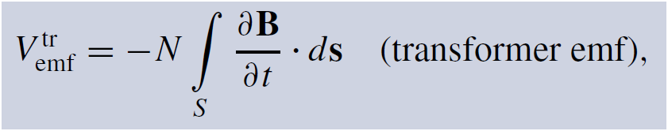
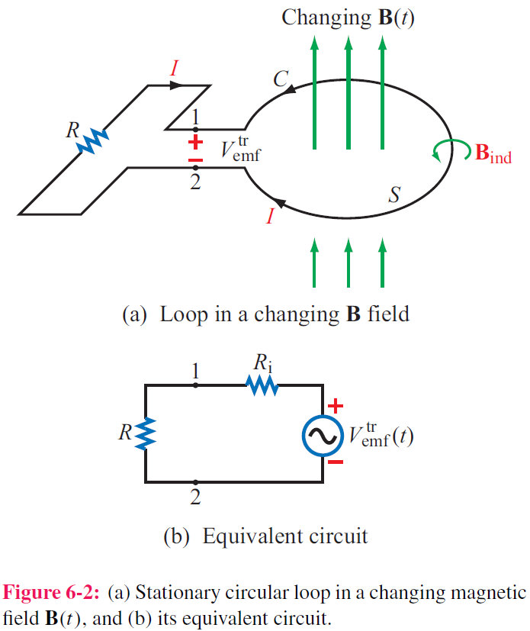
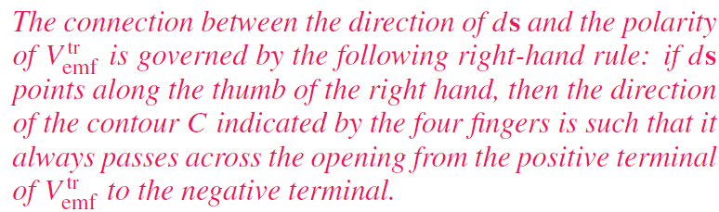
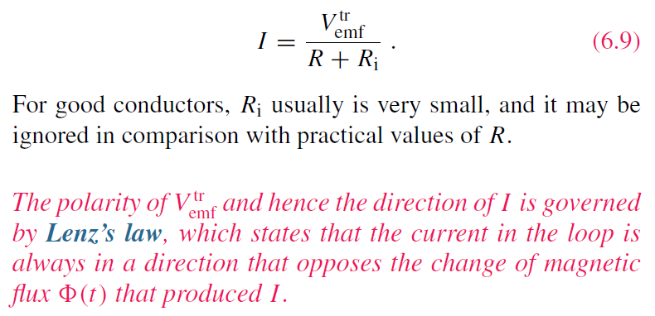
Stationary Loop in Time-Varying B

Slide 7
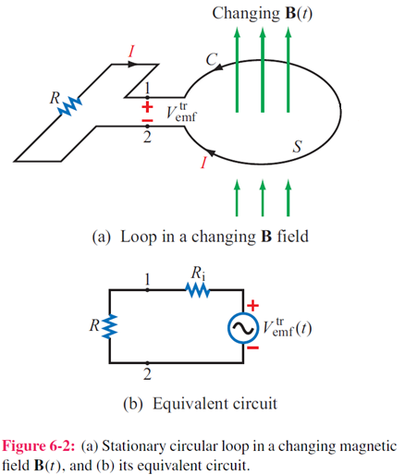
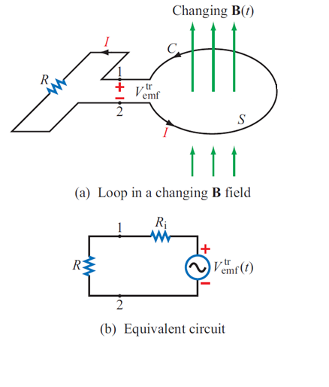
Lenz’s Law
B increases
B decreases
B_{ind}
B_{ind}
<0
>0
B_{ind} serves to oppose the change in B(t), and not necessarily B(t) itself

Slide 8
Faraday’s Law
Establish a link between B and E
Integral form of Faraday’s law
Stokes’s theorem

Slide 9
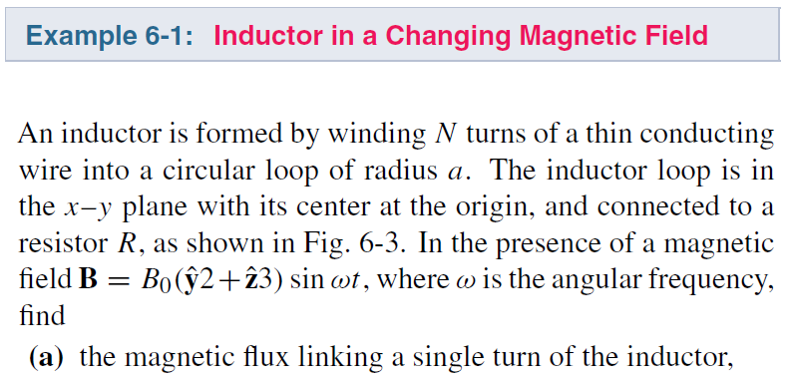
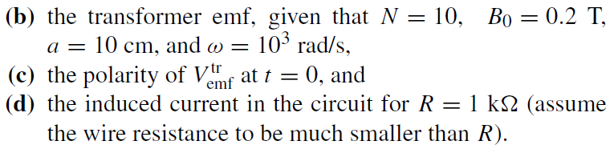
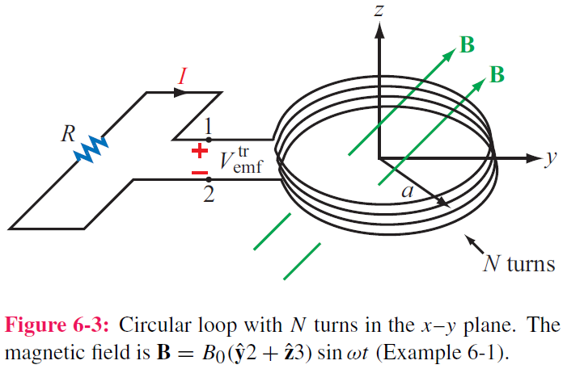
cont.

Slide 10
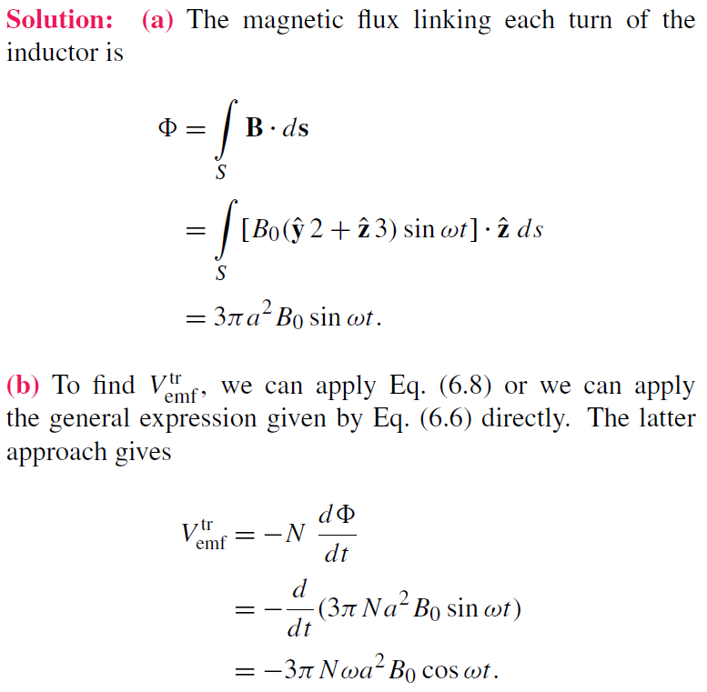
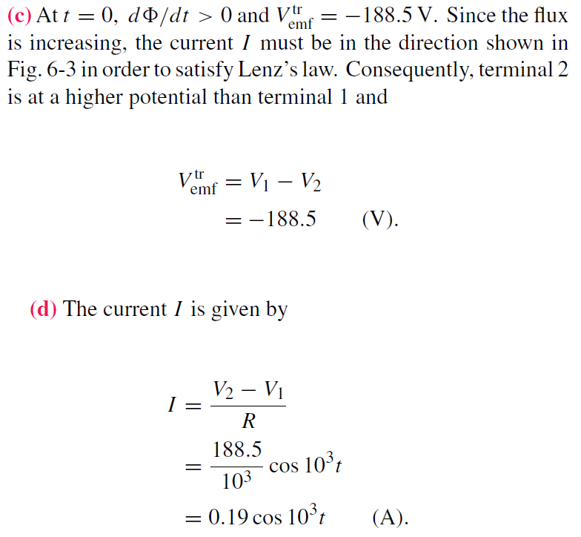
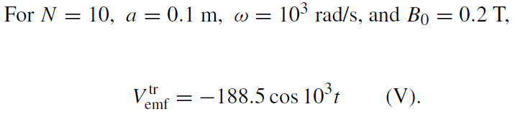
Example 6-1 Solution

Slide 11
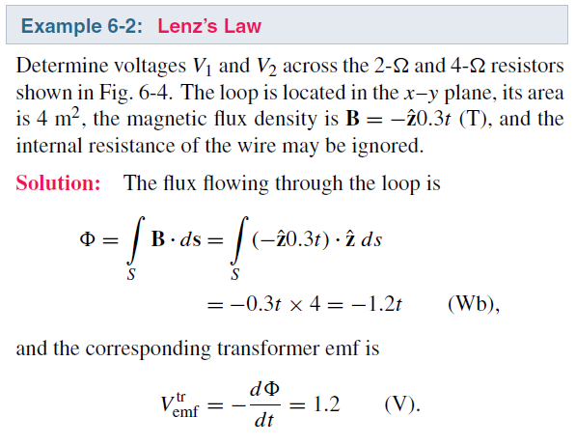
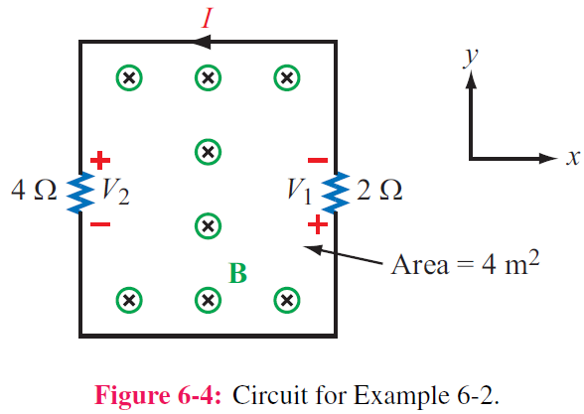
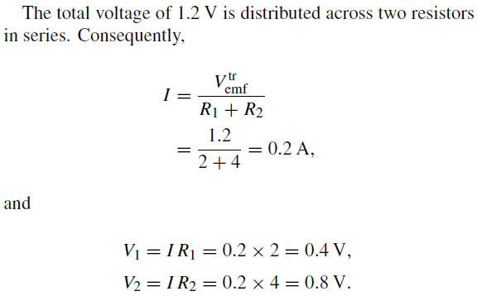

Slide 12
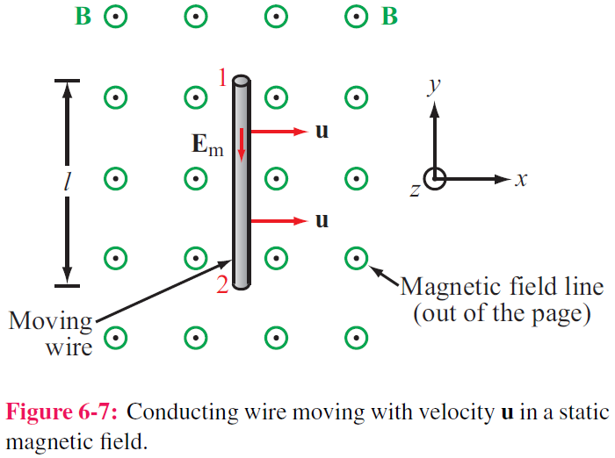
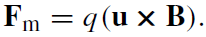
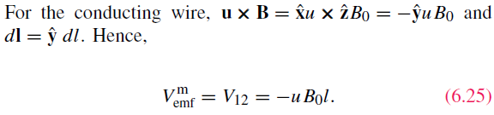
Motional EMF
Magnetic force on charge q moving with velocity u in a magnetic field B:
This magnetic force is equivalent to the electrical force that would be exerted on the particle by the electric field Em given by
This, in turn, induces a voltage difference between ends 1 and 2, with end 2 being at the higher potential. The induced voltage is called a motional emf
E points from 1 to 2

Slide 13
Motional EMF

Slide 14
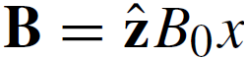
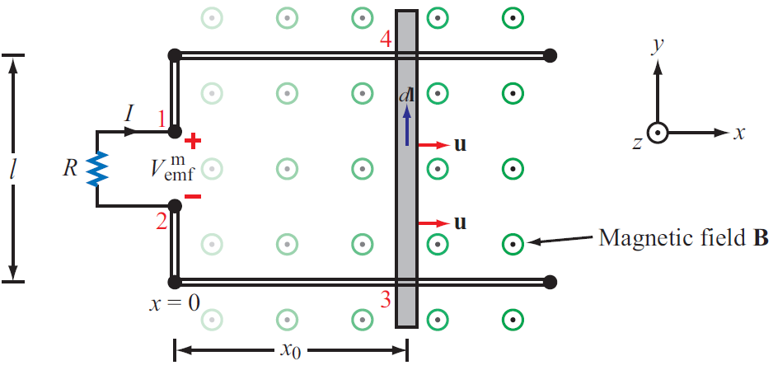
Example 6-3: Sliding Bar
Note that B increases with x
The length of the loop is related to u by x0 = ut. Hence

Slide 15
Example 6-3: cont.
Use Faraday’s law
Note that B increases with x
The same as the result obtained by the motional emf expression

Slide 16
Example 6-4: Moving Loop

Slide 17
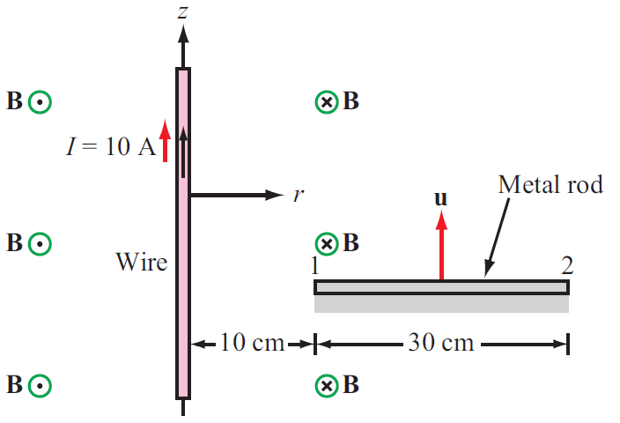

Slide 18
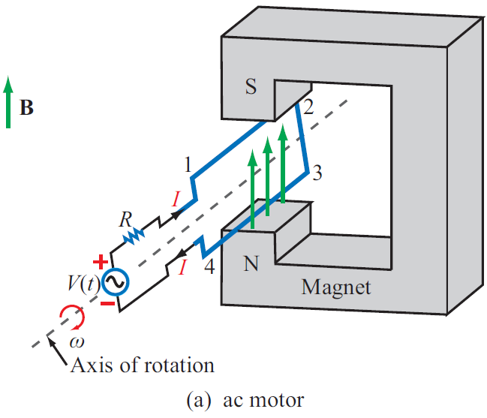
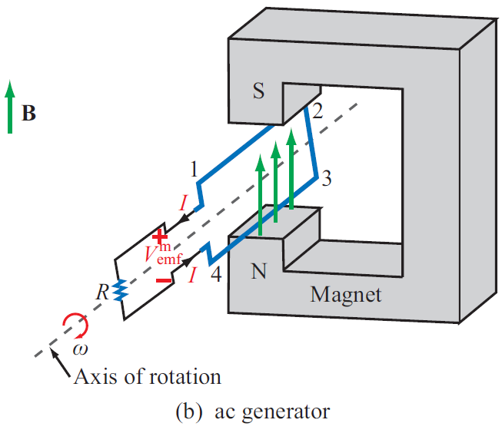
EM Motor/ Generator Reciprocity
Motor: Electrical to mechanical energy conversion
Generator: Mechanical to electrical energy conversion

Slide 19
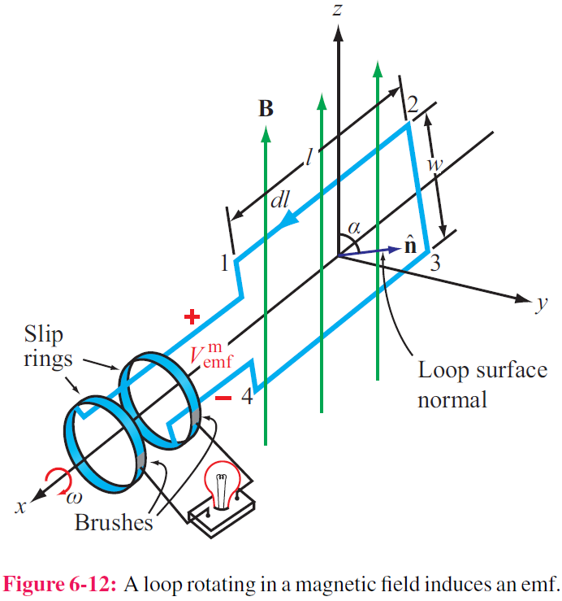
EM Generator EMF
As the loop rotates with an angular velocity ω about its own axis, segment 1–2 moves with velocity u given by
Also:
Segment 3-4 moves with velocity –u. Hence:

Slide 20
Moving Conductor in Time-Varying Magnetic Field
Equivalent

Slide 21
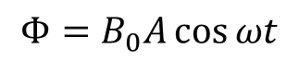
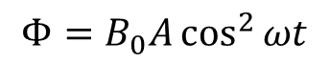
Example 6-6
$$Φ=B_{0}A\cos{ωt}$$
$$Φ=B_{0}A\cos^{2}{ωt}$$

Slide 22
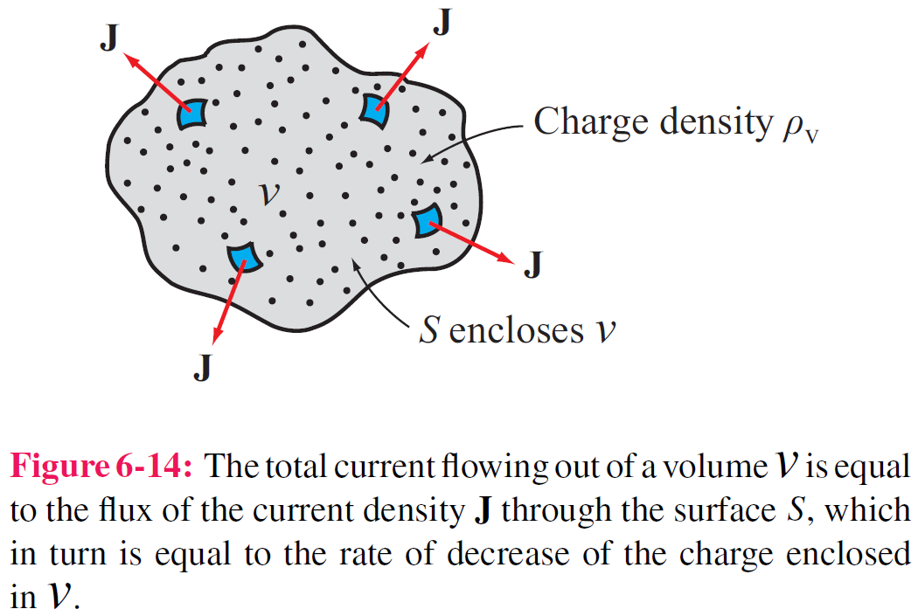
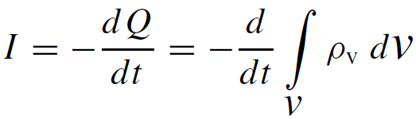
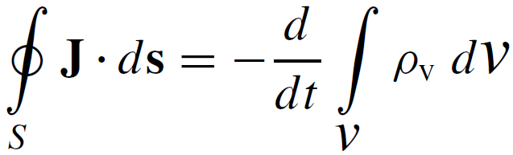
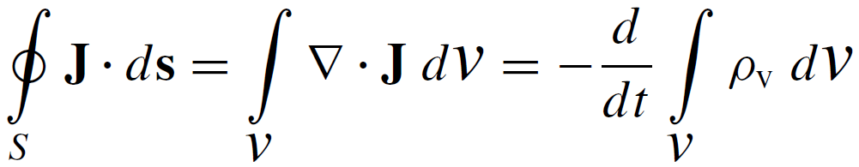
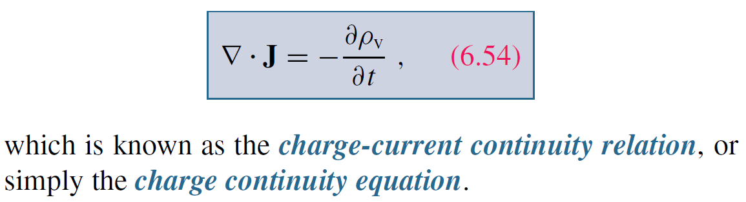
Charge Current Continuity Equation
Current I out of a volume is equal to rate of decrease of charge Q contained in that volume:
Used Divergence Theorem

Slide 23
Charge Current Continuity Equation

Slide 24
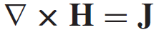
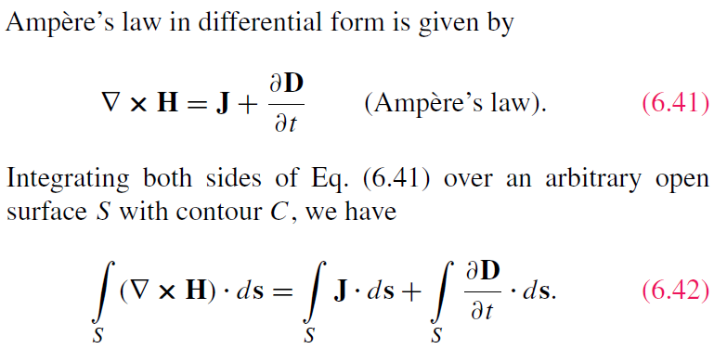
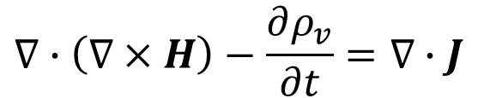
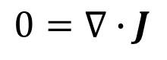
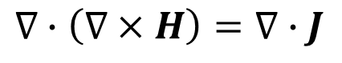
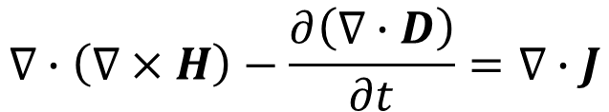
Ampère’s Law for Dynamic Fields
$$∇∙\left(∇×H\right)=∇∙J$$
$$0=∇∙J$$
True for static fields, but not for dynamic fields
$$∇∙\left(∇×H\right)−\frac{∂ρ_{v}}{∂t}=∇∙J$$
$$∇∙\left(∇×H\right)−\frac{∂\left(∇∙D\right)}{∂t}=∇∙J$$
Added by Maxwell

Slide 25
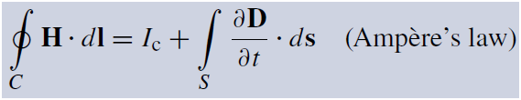
Displacement Current
This term is conduction current I_{C}
This term must represent a current
Application of Stokes’s theorem gives:
Cont.

Slide 26
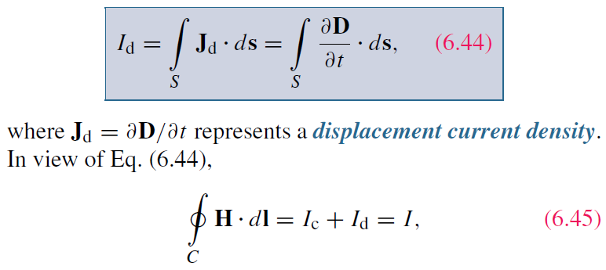
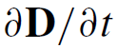
Displacement Current
Define the displacement current as:
The displacement current does not involve real charges;
it is an equivalent current that depends on

Slide 27
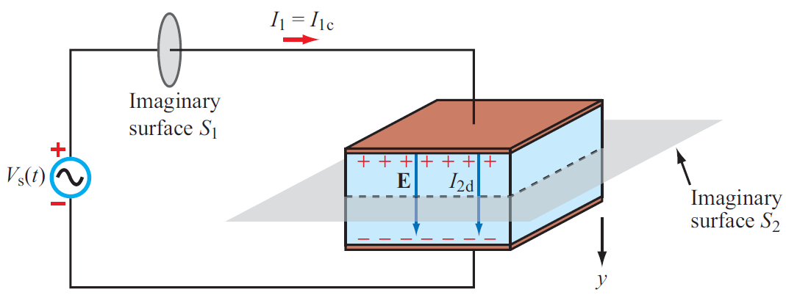
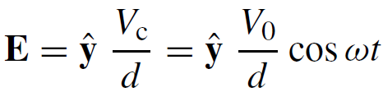
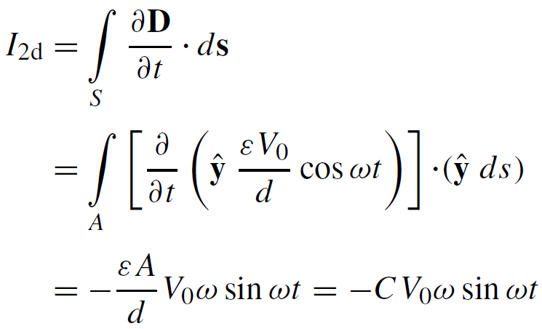
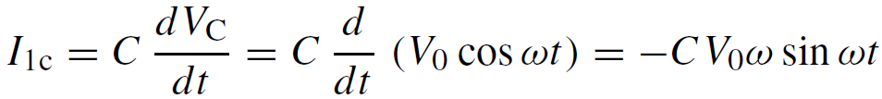

Capacitor Circuit
Given: Wires are perfect conductors and capacitor insulator material is perfect dielectric.
For Surface S₂:
I₂ = I_{2c} + I_{2d}
I_{2c} = 0 (perfect dielectric σ = 0)
For Surface S₁:
I₁ = I_{1c} + I_{1d}
(D = 0 in perfect conductor)
I₁ = I₂ ensures the continuity of total current flow through the circuit
Although the displacement current does not
transport free charges, it behaves like a real current
Conclusion: I₁ = I₂
p298

Slide 28



Slide 29

Boundary Conditions

Slide 30
Charge Dissipation
Question 1: What happens if you place a certain amount of free charge inside of a material?
Answer: The charge will move to the surface of the material, thereby returning its interior to a neutral state.
Question 2: How fast will this happen?
Answer: It depends on the material; in a good conductor, the charge dissipates in less than a femtosecond, whereas in a good dielectric, the process may take several hours.
Derivation of charge density equation:
Cont.

Slide 31
Solution of Charge Dissipation Equation
For copper:
For mica:
= 15 hours

Slide 32





EM Potentials
Static condition
Dynamic condition
Dynamic condition with propagation delay:
Similarly, for the magnetic vector potential:

Slide 33










Time Harmonic Potentials
If charges and currents vary sinusoidally with time:
Also:
we can use phasor notation:
with
Maxwell’s equations become:
Expressions for potentials become:

Slide 34

Cont.

Slide 35

Cont.

Slide 36

Example 6-8 cont.
Cont.

Slide 37

Example 6-8 cont.

Slide 38

Summary

